Slide 1
Online Appeals Screenshots

Slide 2
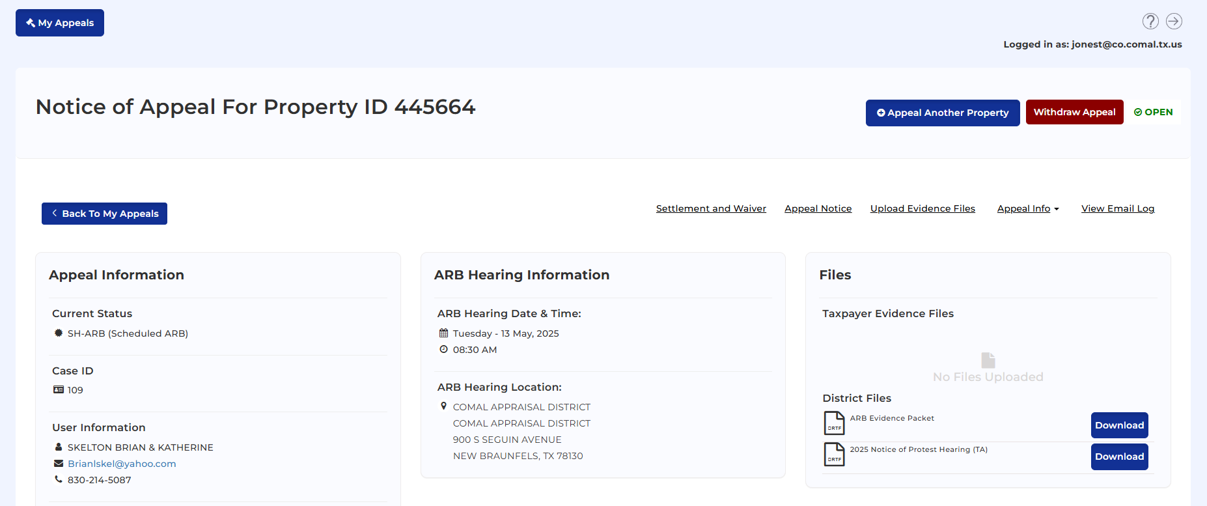
Protest Appeal
123456
Doe, Jane
doej@co.comal.tx.us
(830) 625-8597

Slide 3
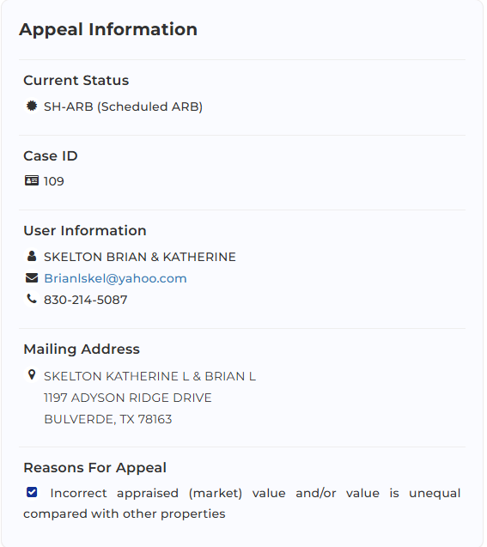
Appeal Information
Protest status code.
Case ID number.
Property owner contact information.
Doe, Jane
doej@co.comal.tx.us
(830) 625-8597
Jane Doe
900 S. Seguin Avenue
New Braunfels, TX 78130
Property owner mailing address.
Reasons for protest.

Slide 4
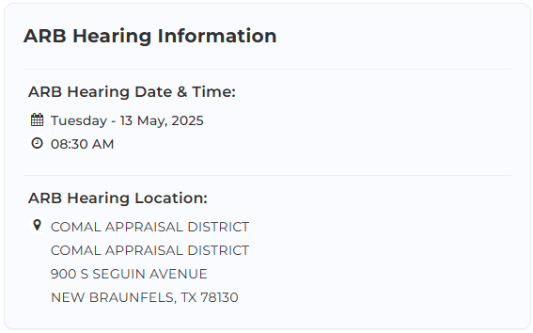
ARB Hearing Information
Hearing scheduled date and time.
Hearing location.

Slide 5
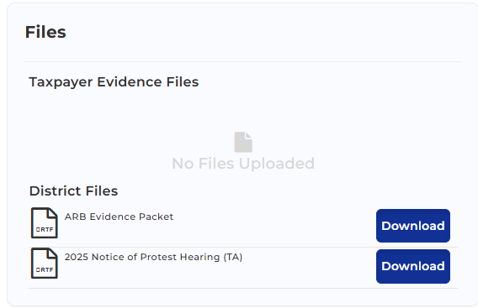
Files: Evidence and Notices
Taxpayer documents that has been uploaded to online appeals portal.
CAD documents. Evidence & Hearing notices.

Slide 6
Upload New Evidence: Taxpayer
123456
Doe, Jane
doej@co.comal.tx.us
(830) 625-8597

Slide 7
Withdraw Appeal
123456
Doe, Jane
doej@co.comal.tx.us
(830) 625-8597

Slide 8
View Offer and Settlement & Waiver
123456
Doe, Jane
doej@co.comal.tx.us
(830) 625-8597

Slide 9
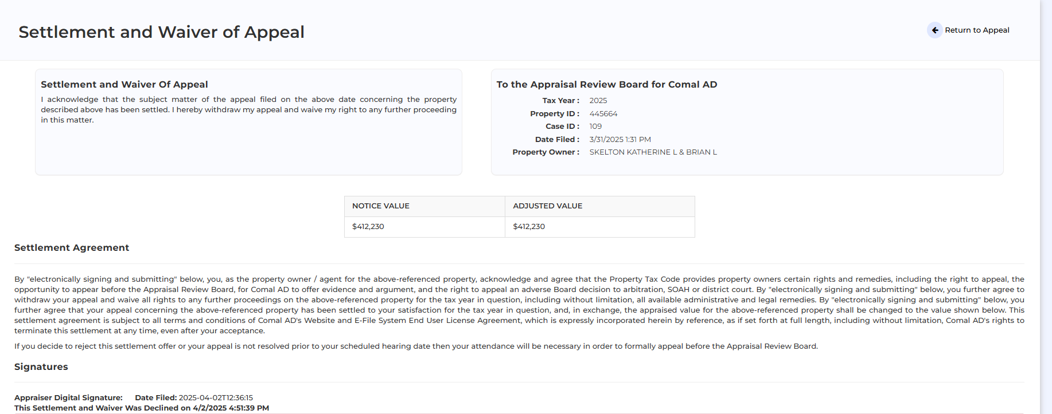
Settlement & Waiver
123456
Protest information.
Doe, Jane
Offered value.
Boxes to check to accept or decline offered value.

